Slide 1
Art REbels
Engaging projects-What to do with those 5th graders at the end of the year

Slide 2

Value scale

Slide 3
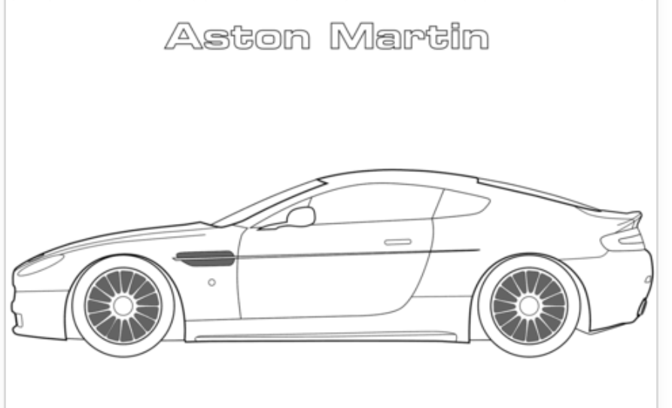
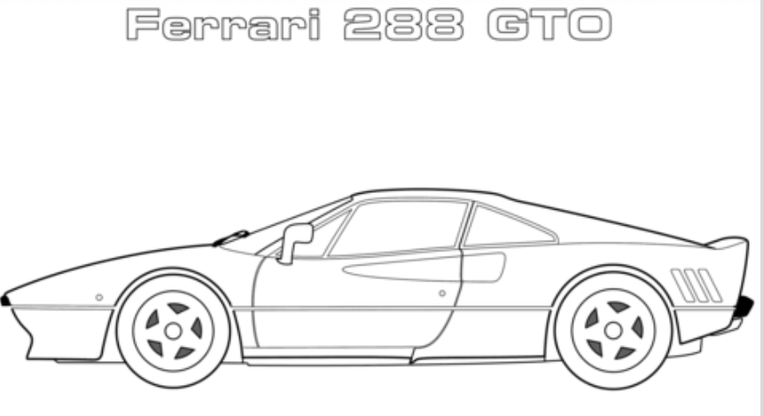
Exotic cars

Slide 4
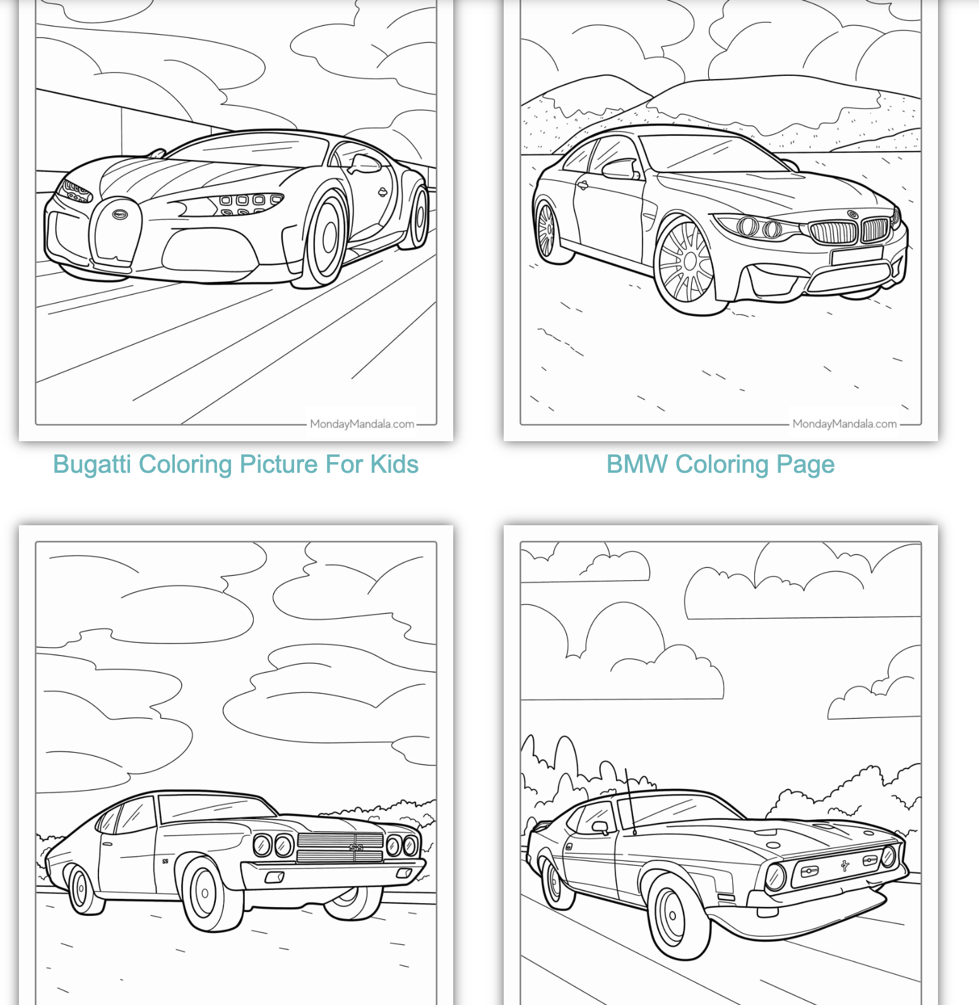
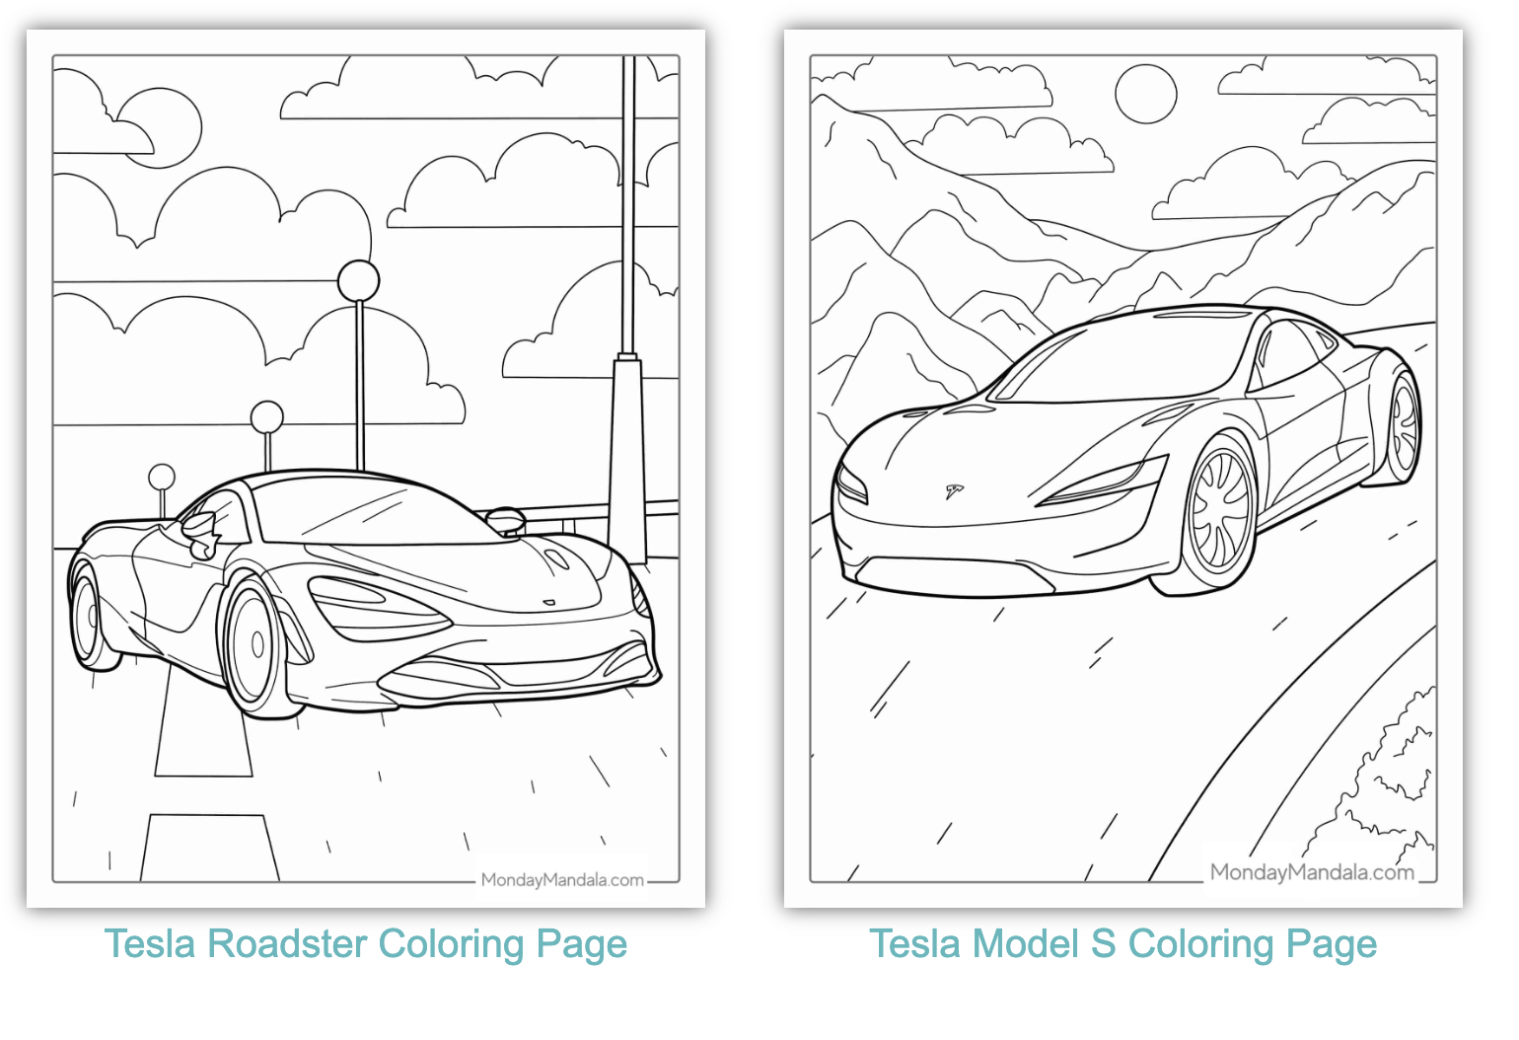
Coloring sheets as contour line visuals

Slide 5
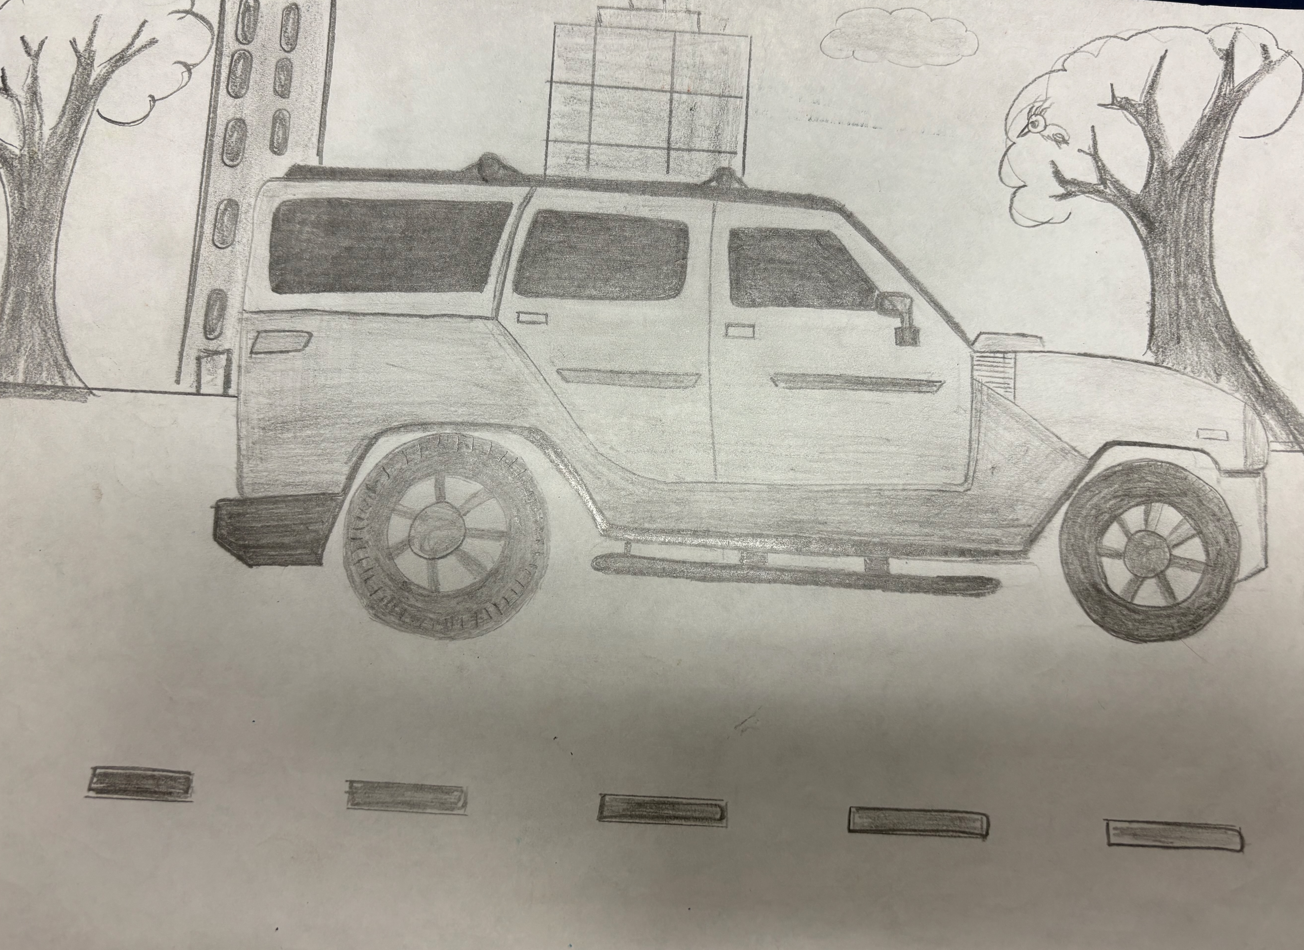
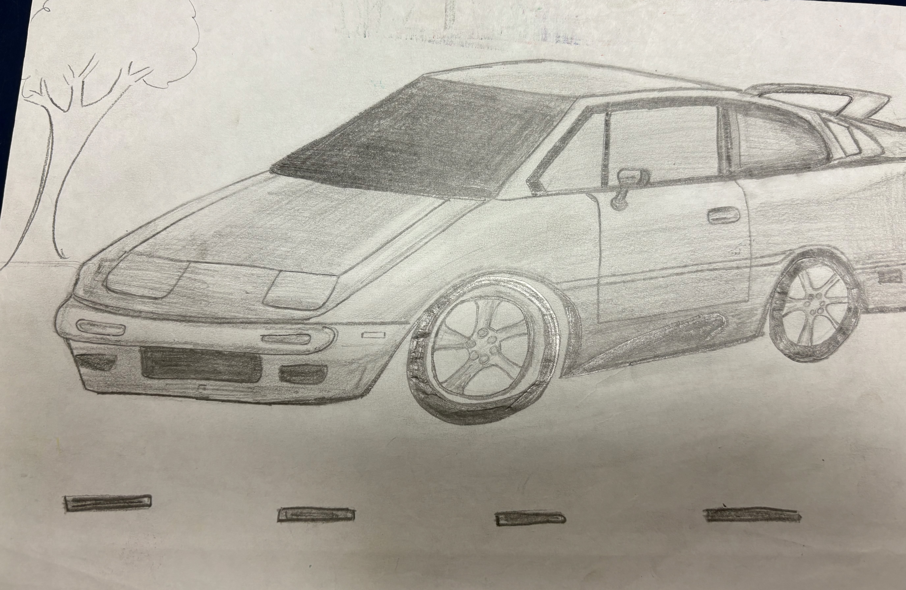
Examples

Slide 6
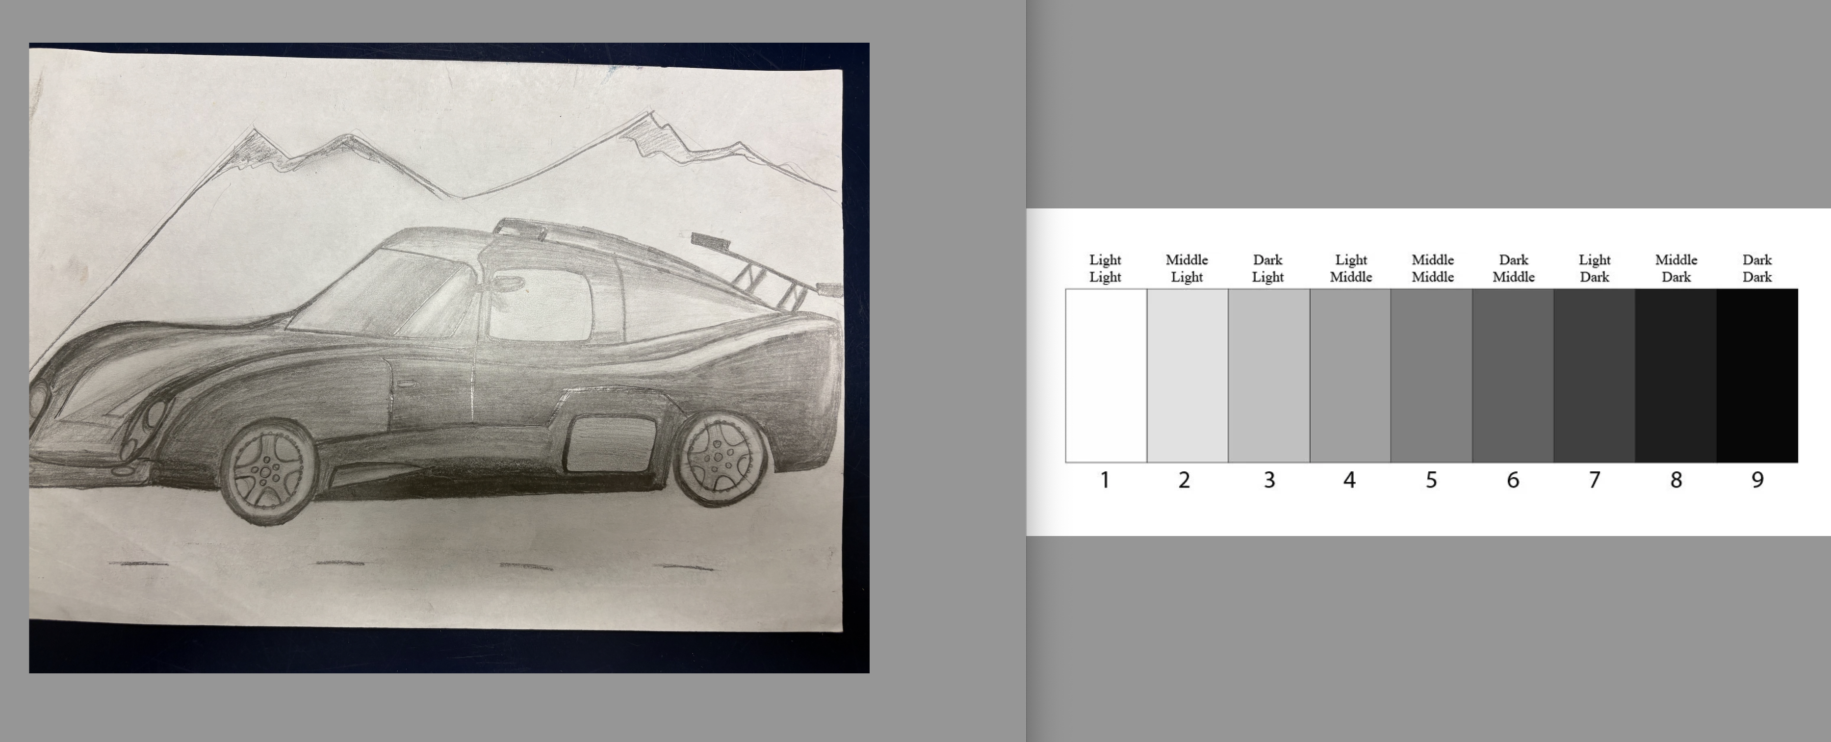
Example

Slide 7
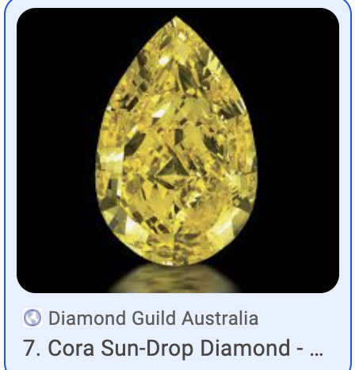
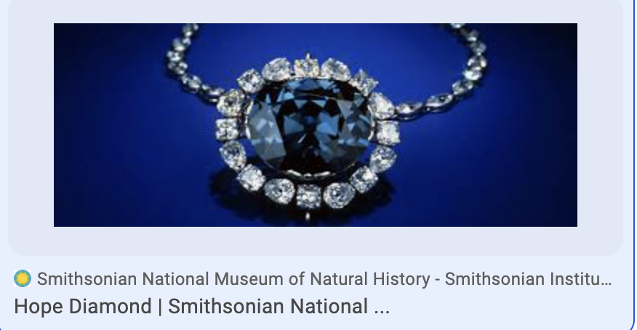
Gems or Jewels-Cora sun diamond worth 12 million or Hope diamond worth $300 million

Slide 8
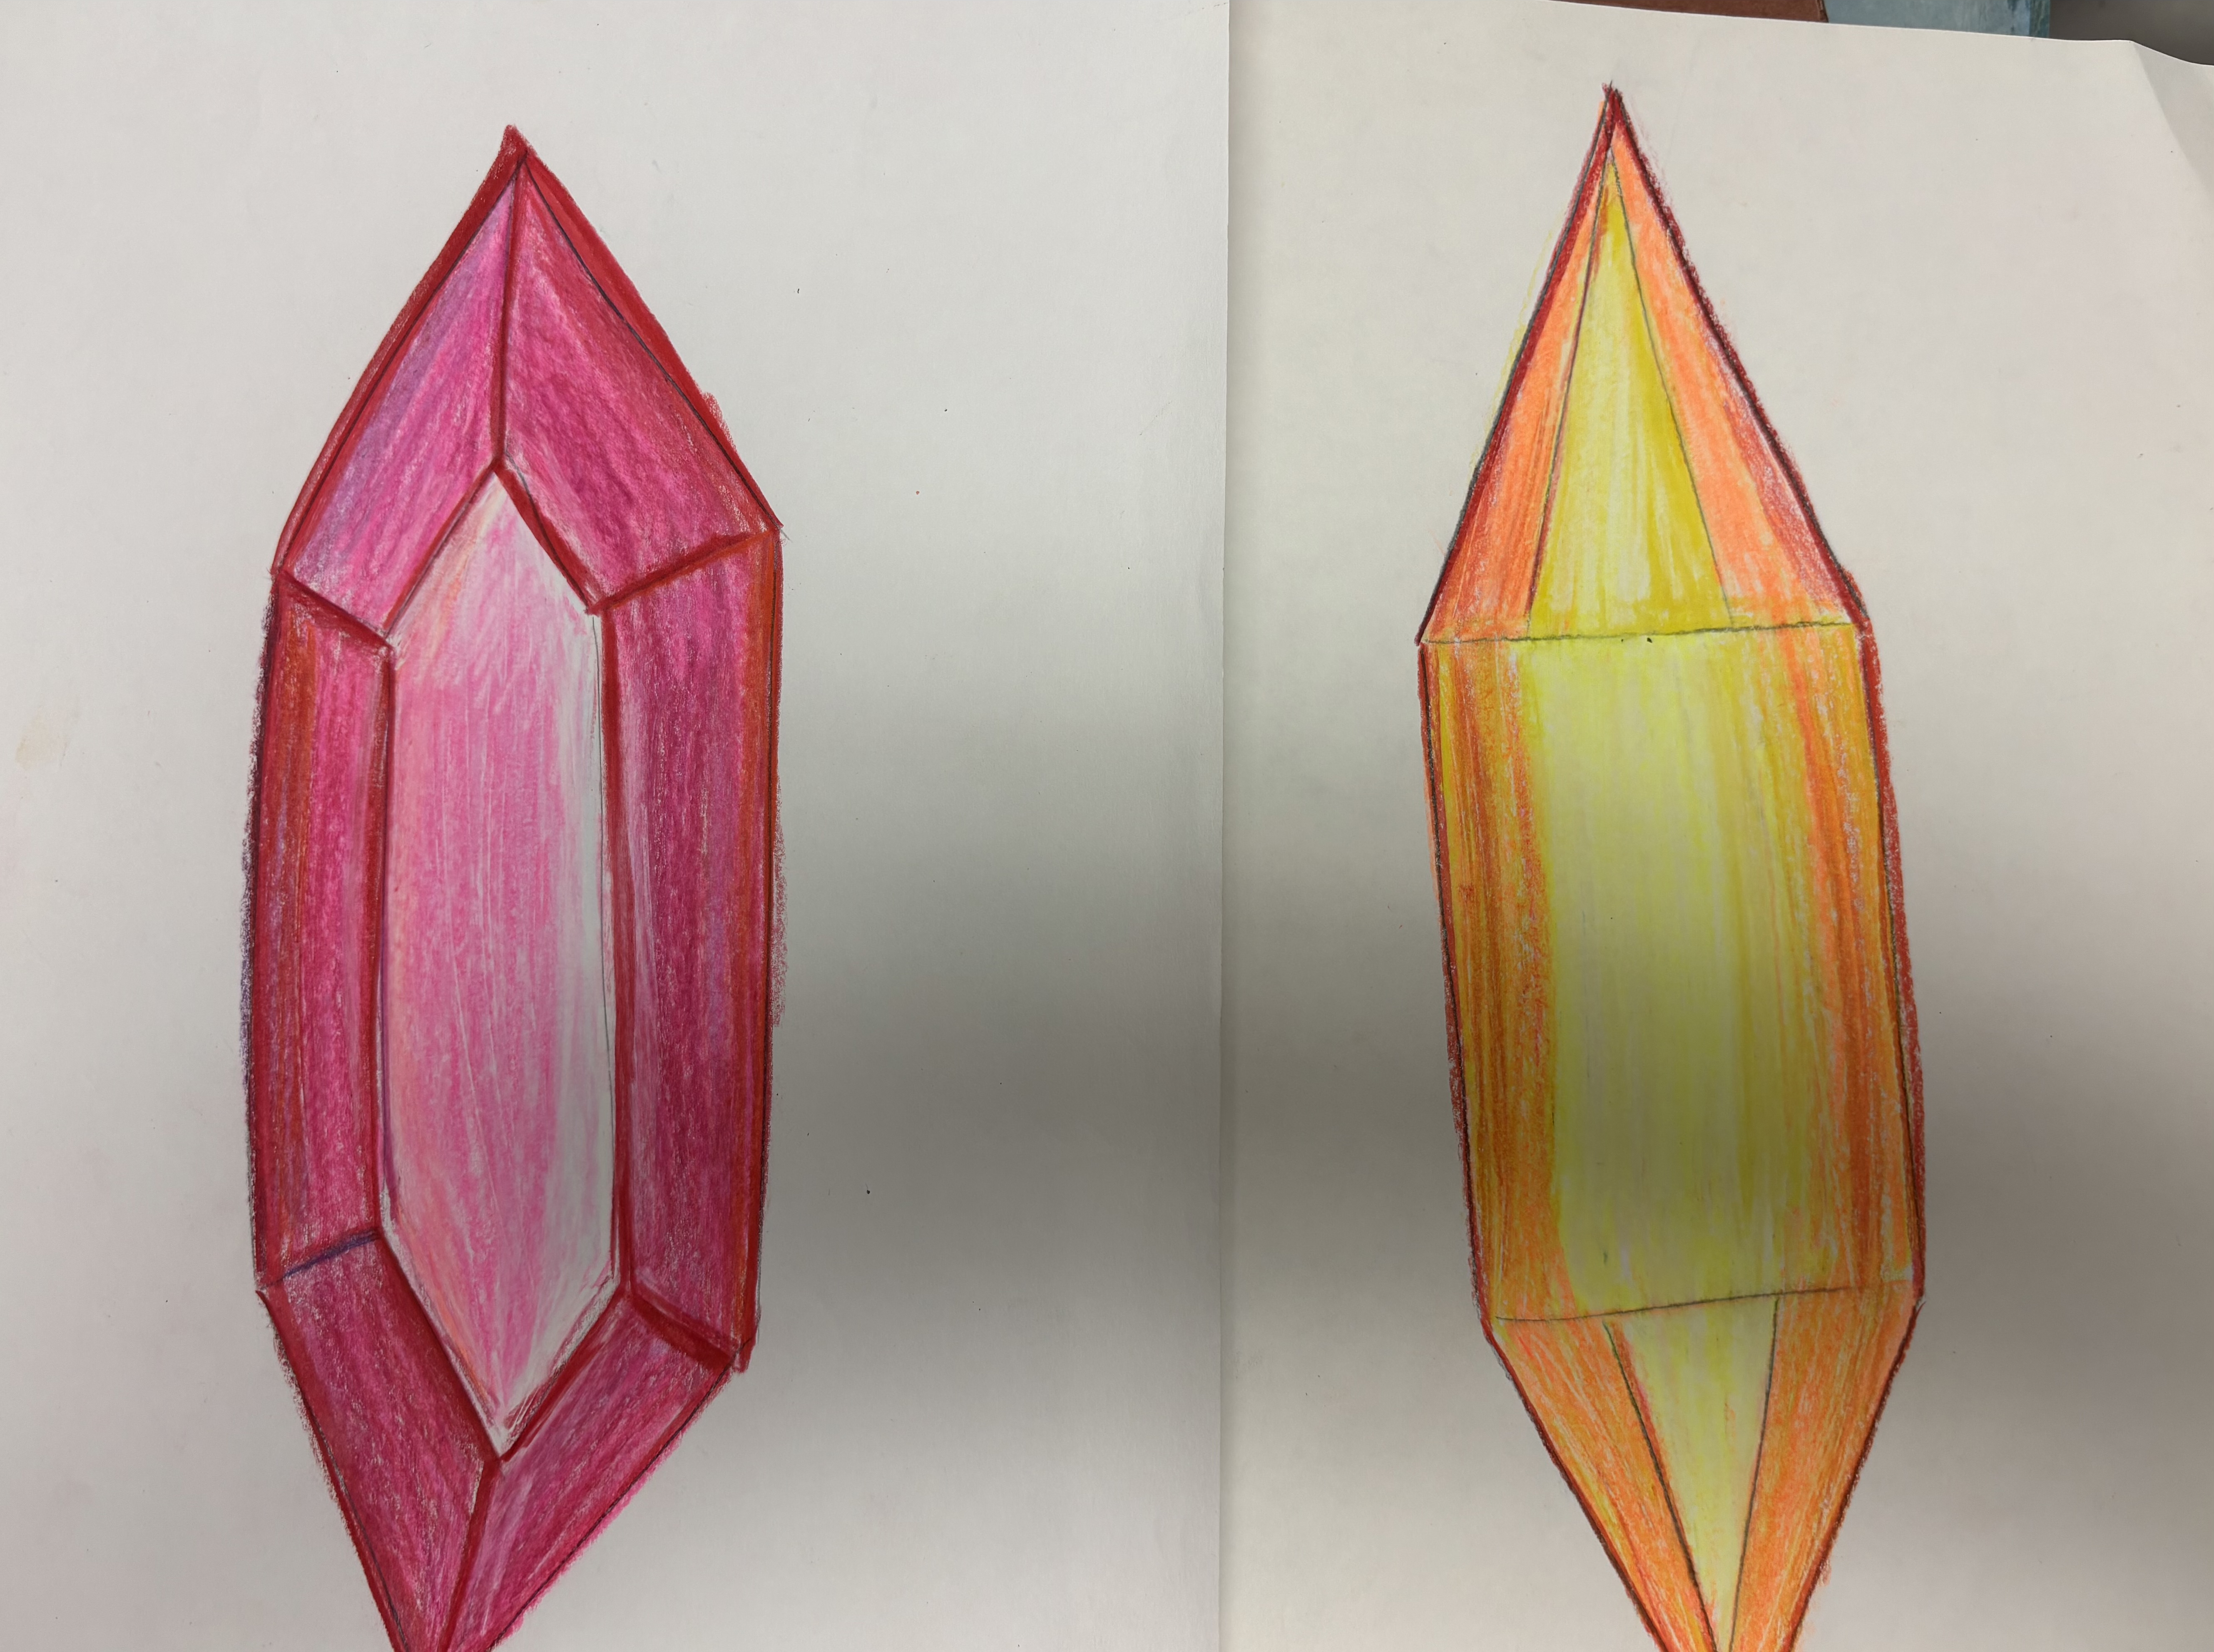
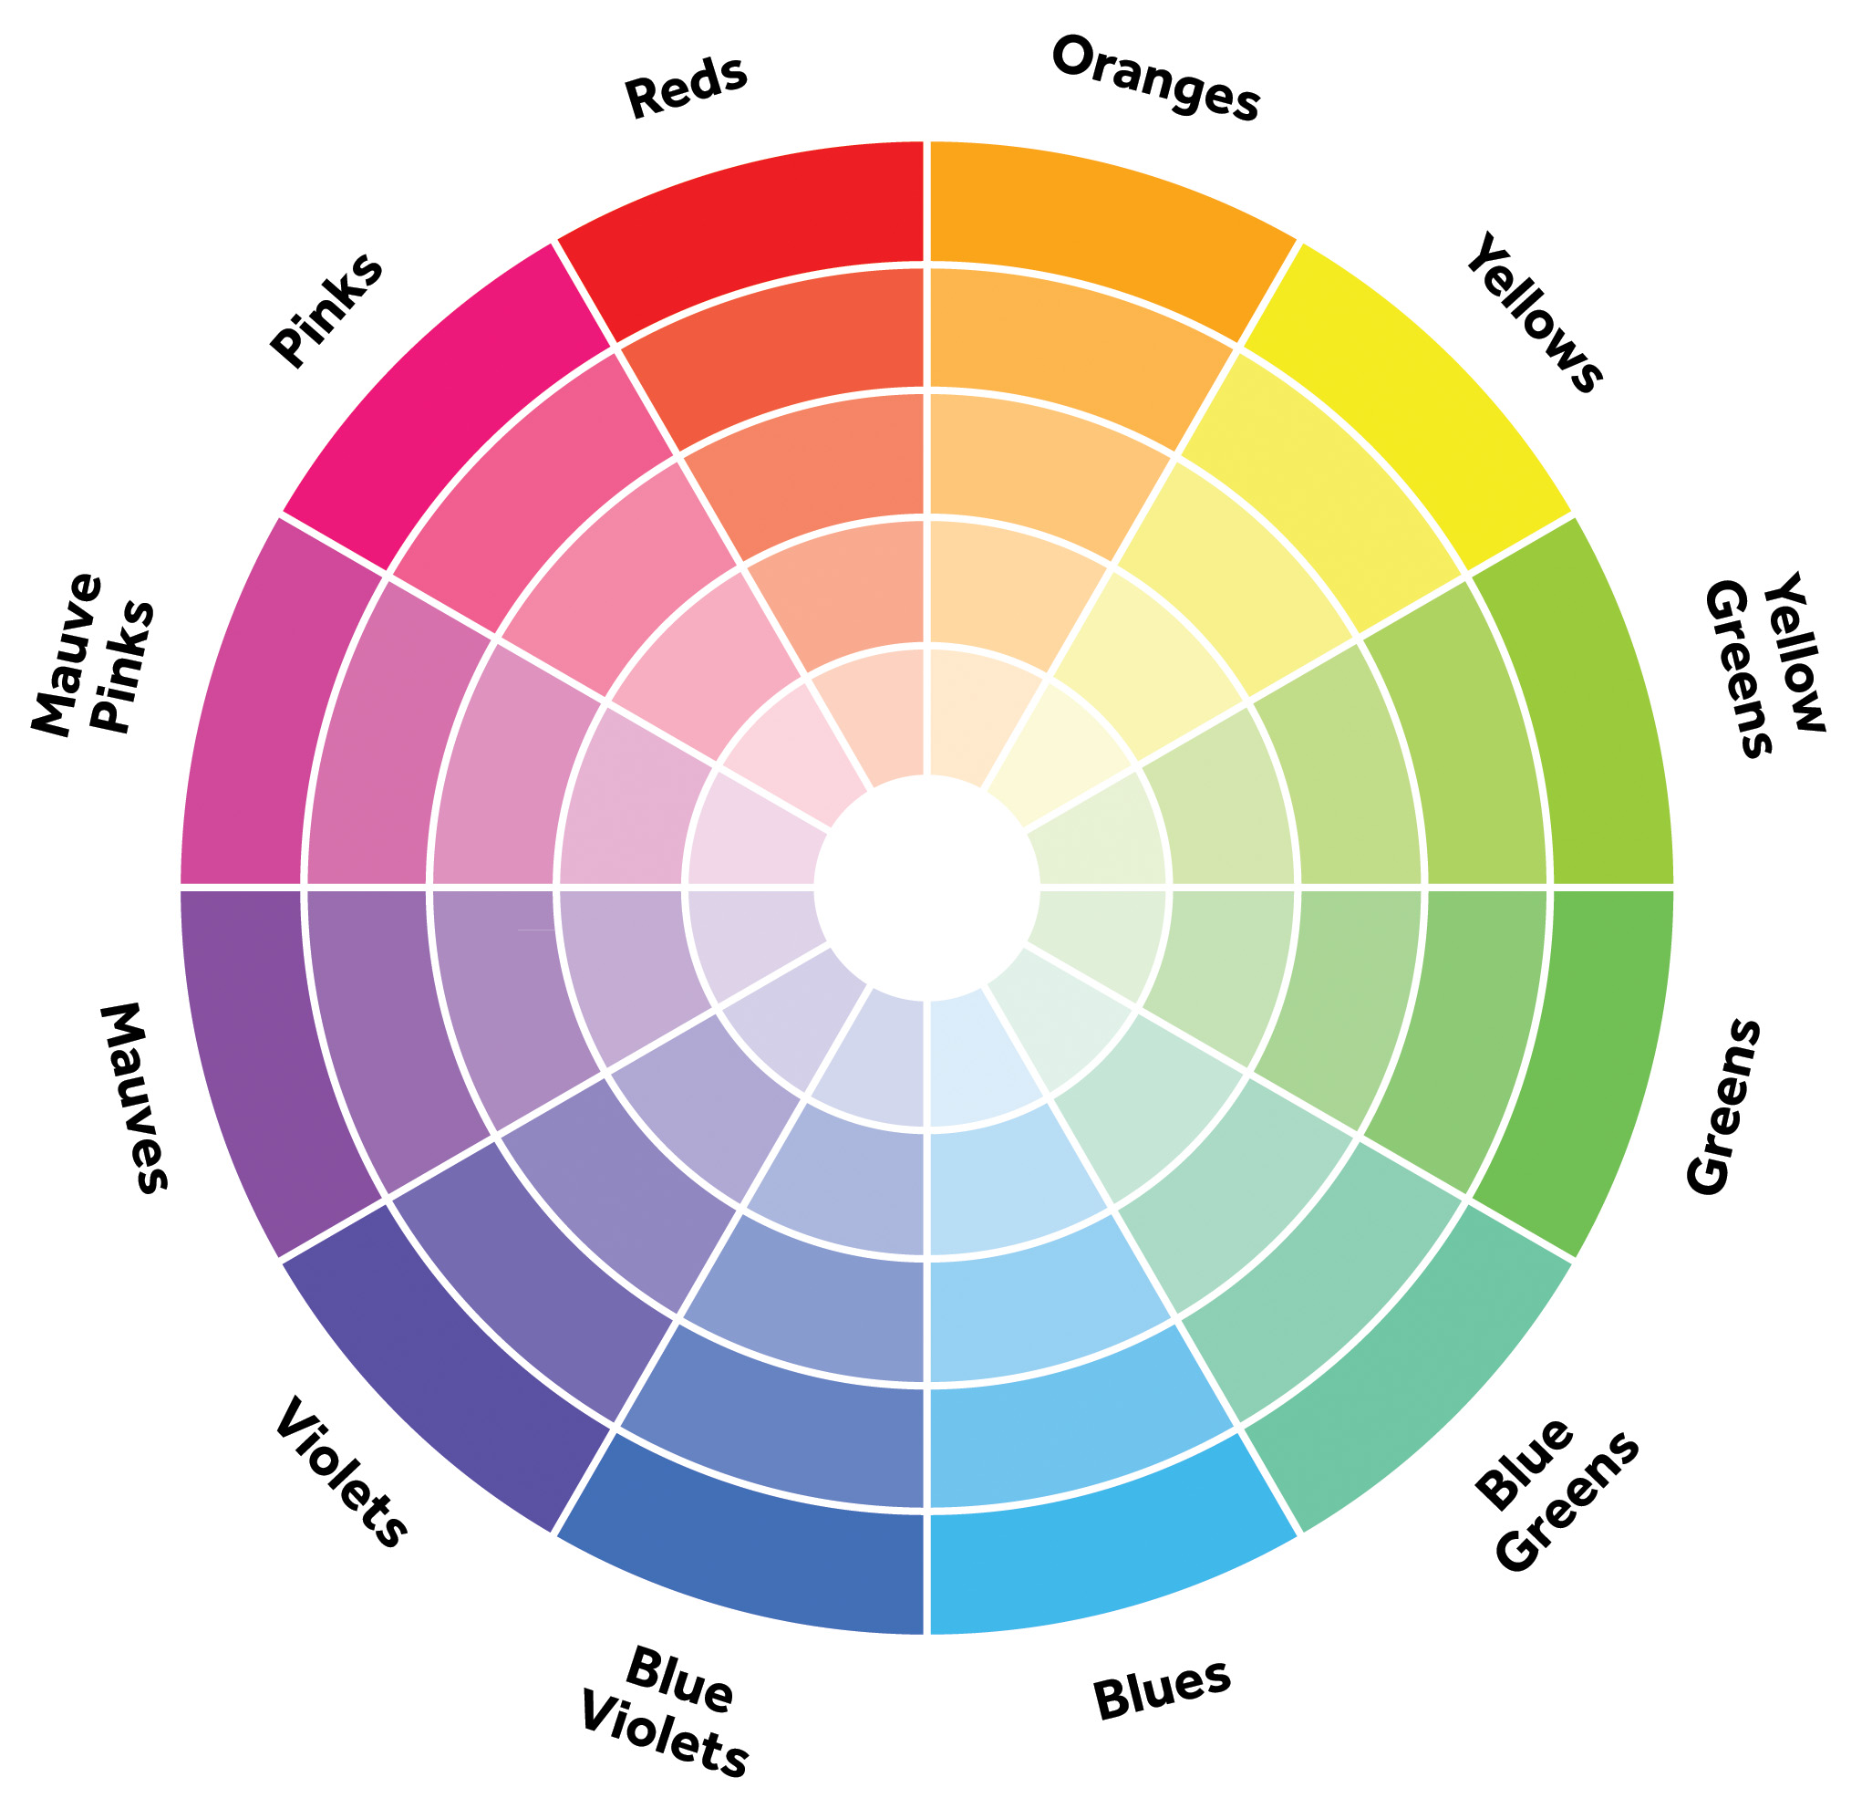
Use color sticks or colored pencils to create gem or jewels with value

Slide 9
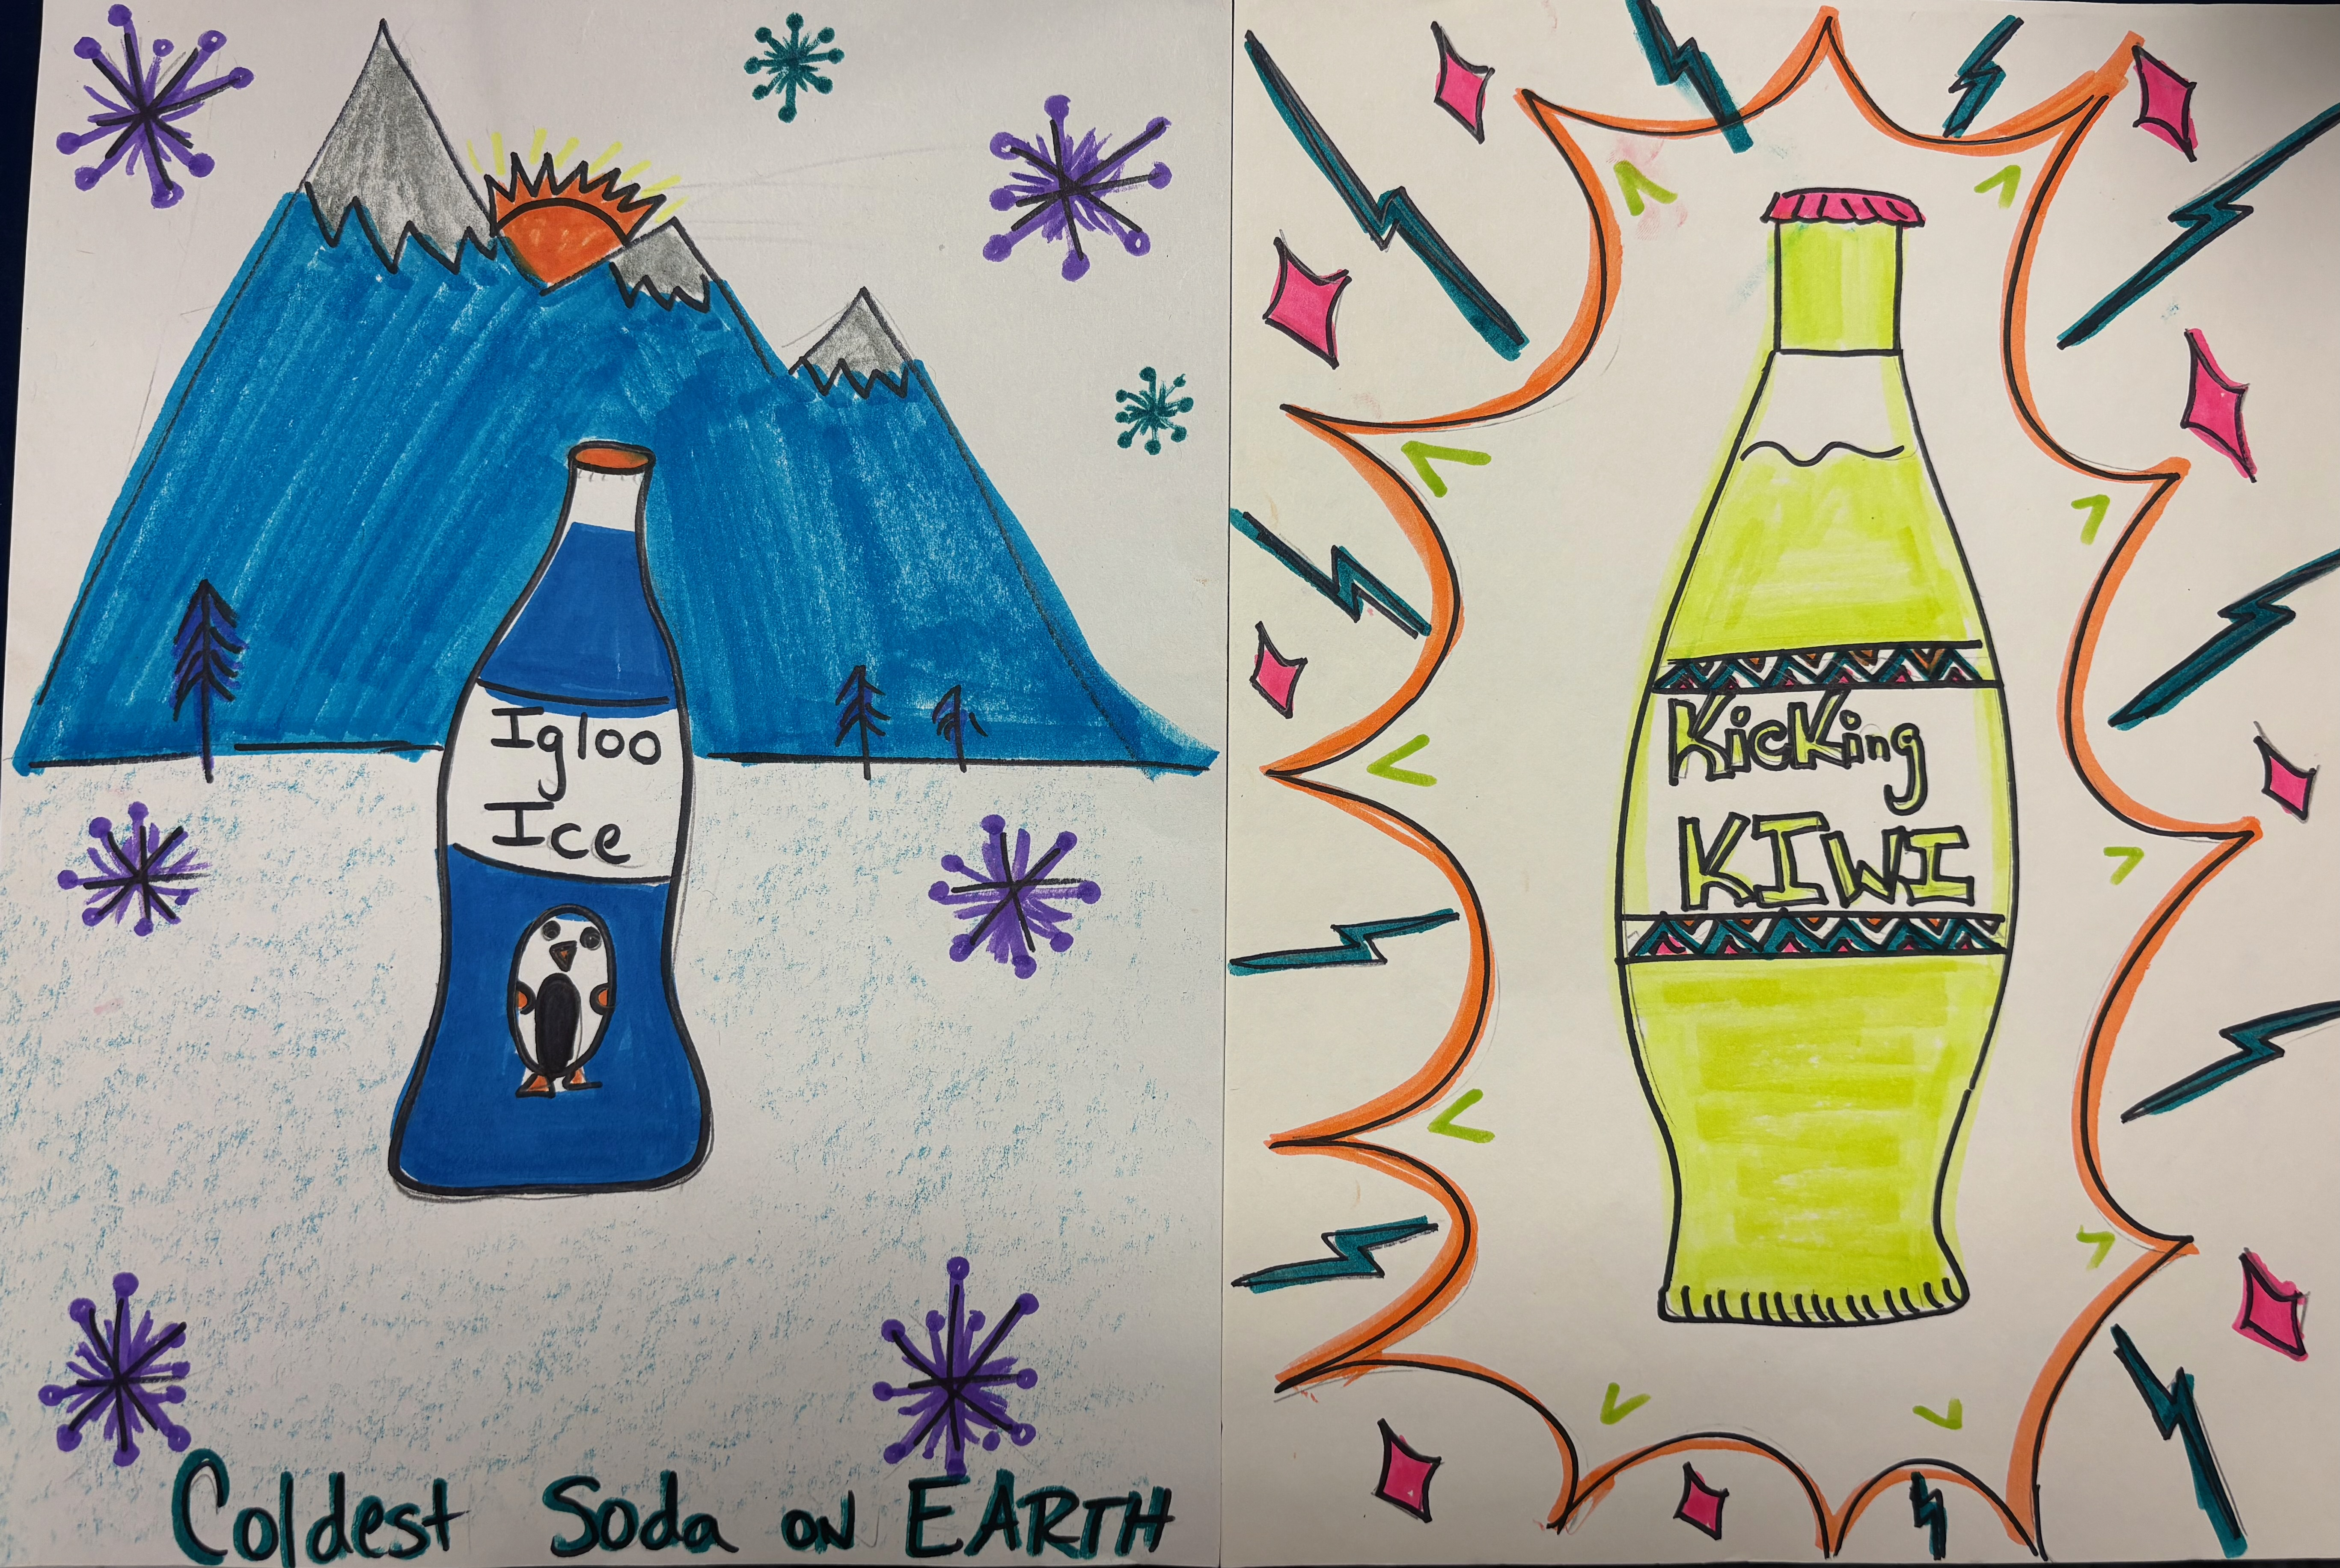
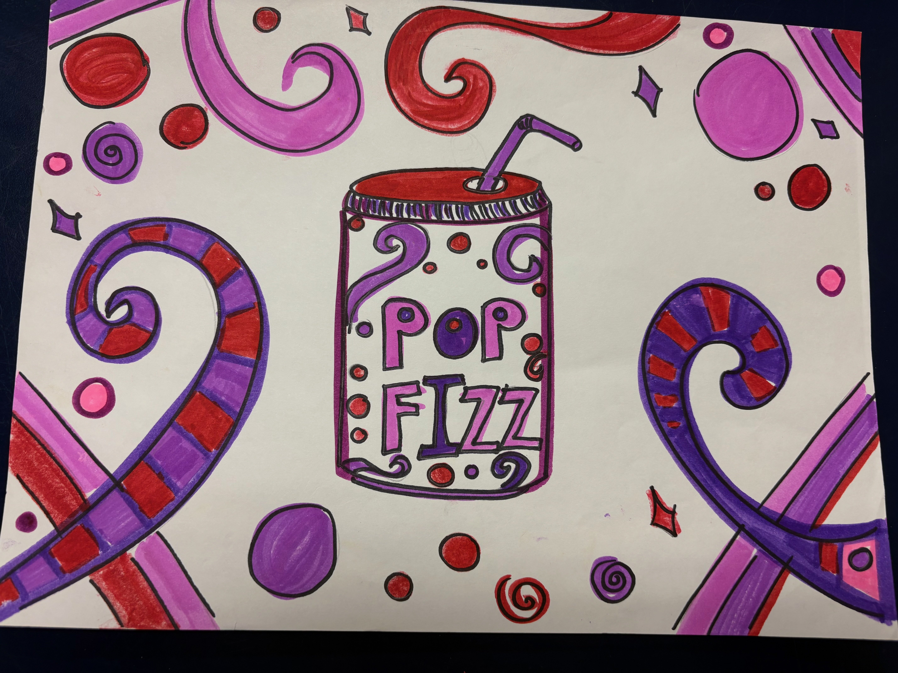
Soda design-Create flavor a unique or traditional flavor and a design that go with soda?

Slide 10
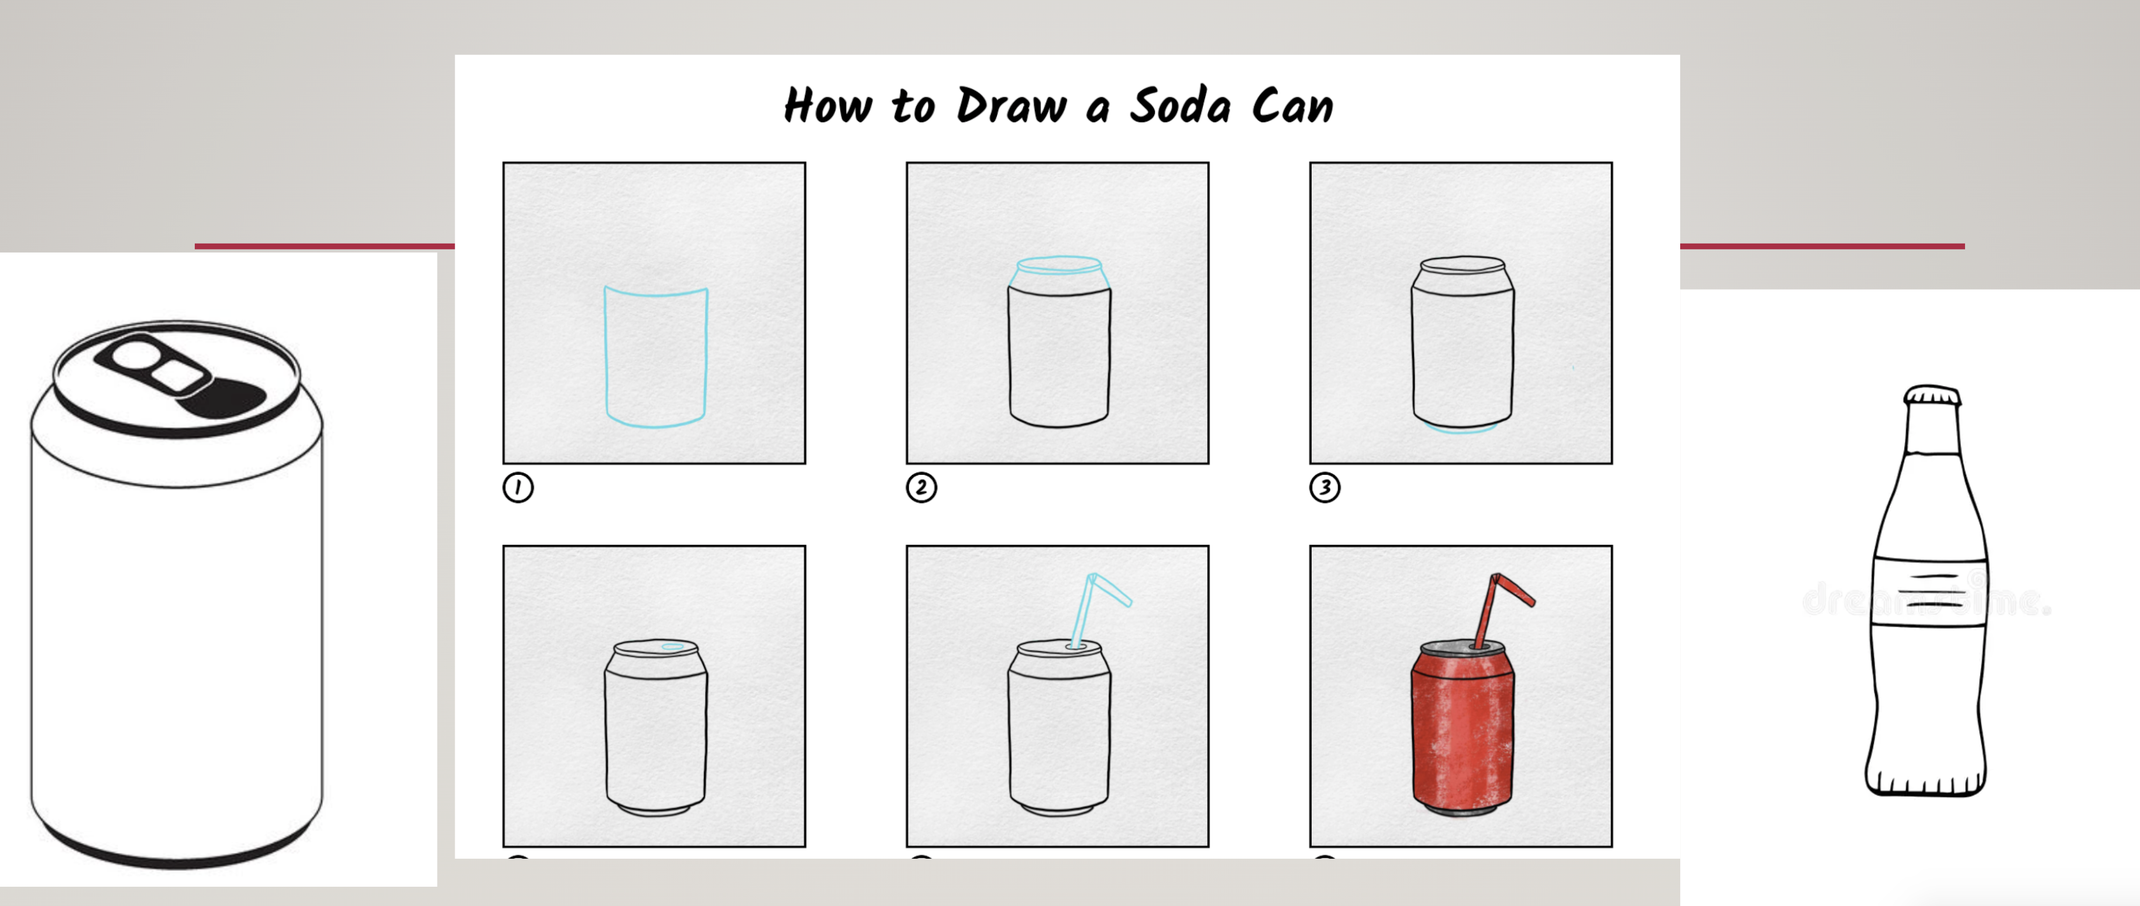
How to draw a soda

