Slide 1


Slide 2

Hello! My Name is Gretchen Martinez and I am
thrilled to be your child’s first grade teacher! This will be my 25th year teaching and and my 6th year at MAC, and I absolutely love it here. I graduated from The University of Toledo with a bachelor’s degree. I have a passion for learning and teaching. In my free time, I enjoy relaxing in the pool, reading, and spending time with family, dogs, and friends.

Slide 3

8:00 – 8:25 - Morning Activities
8:25 - 8:40 - Phonemic Awareness
8:40 - 9:25 - Reading Whole Group
9:25 – 10:05 - Block (Music, Library, Spanish)
10:05 – 10:35 – M.A.C. Time (Small Group Instruction)
10:35 – 10:55 - Phonics
11:00-11:15 - Recess
11:17 - 11:41 - Lunch
11:45 – 12:15 – Writing
12:20 – 1:20 - Math
1:25-2:05 – Specials (M, T,TH, F – P.E., W- Art)
2:05 – 2:15 – Snack
2:15-2:45 – Science/Social Studies
2:50 – 2:55 - Clean up
3:00 - Dismissal

Slide 4

1. Follow directions the first time they are given.
2. Raise your hand and wait to be called on.
3. Keep hands, feet, and other objects to yourself.
4. Use kind words and good manners.

Slide 5
M.A.C.’s Schoolwide Expectations
1. Follow directions
2. Takes responsibility for own actions; demonstrates self-control
3. Completes and submits quality classwork
4. Listens respectfully and acknowledges the thinking of others
5. Displays best effort
6. Uses technology in accordance with school policies
7. Follow dress code expectations

Slide 6


We have several different classroom rewards which include:
  *Treasure Box
  *Verbal Praise
  *Class Rewards
  *Earning Individual Paw Prints
  *Earning Class Paw Prints
  *Earning Positive Referral to the Office

Slide 7

Our class has snack time daily in the afternoon.
Families are asked to send in a class snack (enough for 18) once a month. Students are also welcome to bring their own snack.
Students are encouraged to bring a refillable water bottle each day. It is preferred that the water bottle have a flip top closure.
The school has water refill stations available.

Slide 8

Please utilize MySchoolBucks to keep money in your child’s lunch account and monitor their purchases.
Students have the option to purchase cookies, fruit snacks, and juice boxes at lunch for an additional charge.
There are no lunch visitors allowed at this time.

Slide 9

McKeel Academy Central utilizes a traditional grading scale.
A: 90-100
B: 80-89
C: 70-79
D: 60-69
F: 0-59
This year, writing grades will be included in your child’s overall Language Arts grade.
Graded assignments will be sent home on Friday in your child’s yellow Take Home folder. Please be sure to review assignments and remove all papers before returning the folder the following Monday.

Slide 10

School begins at 8:15 a.m.
Students must be at school for at least 50% of the school day, or they will be marked as absent. (11:30 am)
Please hold onto any doctor’s notes,
as we will not collect them at school.
Upload Doctor’s Notes: You can upload doctor’s notes by logging into McKeel Systems and selecting “attendance.” There is an option to “upload note.” Please do not turn paper notes into the school.

Slide 11
Automatic Notifications:
Parents will receive an automated email from Systems every 5 absences.
Communication:
Email your child’s teacher if you have an extended pre-planned absence (e.g., medical procedure or other important reasons).
*Excessive absences could result in attendance probation, and persistent attendance issues may lead to dismissal from McKeel Academy Central. Excessive absences, tardies, or early checkouts will be reviewed by administration to identify the causes and determine appropriate actions.

Slide 12
Arrival Information:
Students should be dropped off in the car line by 8:10 a.m. so that we can have all students in the classroom by 8:15 a.m. and ready for the start of the school day. Any student arriving after 8:15 a.m. is considered tardy.
Dismissal Information:
Dismissal will begin promptly at 3:00 p.m. Please make sure you are in the car line and ready to pick up your child.
Afternoon walk-up is available for all students. Parents must have a car tag with them in order for your child to be called.

Slide 13

All uniforms should come from Risse Brothers.
Students are expected to wear their McKeel collared uniform shirt along with school uniform bottoms. Please make sure your child is wearing a belt if bottoms have belt loops.
Only solid, navy blue jackets or a McKeel branded hoodie/jacket are allowed.

Slide 14
On Fridays, students may wear jeans for a $1 or school uniform bottoms and their McKeel spirit t-shirt.
Jeans should be solid blue with no frays or designs.
All uniform bottoms should be mid-thigh or longer.
*MAC has a clothes closet available if needed.

Slide 15

This year, we will use standards-based thematic units for Reading and Big Ideas Math for our curriculum.
Additionally, we use the Phonics First program, which includes the red words and High Frequency Words (Sight Words) that students will learn throughout the year.
In science, students will participate in a variety of hands-on experiments throughout the year. We will also utilize Scholastic News to help teach social studies.

Slide 16

Reading
Students will…
identify and describe the main story elements (characters, setting, events) in a text.
identify and explain the moral
of a story.
explain who is telling the story using context clues.
use text features to demonstrate understanding of the text.
identify the main topic and relevant details in a text.
identify an author’s opinion about a text.

Slide 17
Phonics First Program
This is a multisensory, systematic, structured, sequential, phonics-based, direct instruction that teaches students how to decode (read) and encode (spell).
Weekly lessons will teach students various spelling patterns throughout the year. Students will participate in daily activities to reinforce the weekly phonics skill.
Students will be given a spelling test each Friday to check for understanding of the weekly phonics skill. Students will also be given a sentence to dictate (write). These assessments will be placed in your child’s portfolio.

Slide 18
High Frequency Words
Red words are typically non-phonetic sight words that require memorization because they cannot be sounded out using phonetic rules. Students will be working on reading and spelling the red words.
Sight words provide an excellent base for reading at an early age. These words can be found frequently in a text. Sight words are typically words that students can recognize immediately and can read without having to decode (sound them out).
We will be using the red word and high frequency word first grade list this year.

Slide 19

Writing
Students will…
write narratives to retell two or more sequenced events.
write opinions about a topic with at least one
supporting detail and a sense of closure.
write expository texts about a topic, using a source, providing facts and a sense of closure.
follow the rules of grammar, capitalization, punctuation, and spelling.

Slide 20




Math
Students will learn…
Numbers to 120 (count forward, backward,
skip count by 2’s, 5’s, 10’s)
Place Value (tens/ones, greater than/less than)
Addition & Subtraction (strategies, fluency, fact families, two-digit numbers, regrouping)
Measurement (length in inches & centimeters)
Time (hour & half-hour)
Money
Geometry (2D & 3D shapes)
Data Analysis

Slide 21



Science
Students will learn…
The Practice of Science (science tools, scientific method, 5 senses)
Matter
Force & Motion
Earth in Space & Time (gravity, stars, the sun)
Earth’s Structures (natural resources)
Life Science (living vs non-living, plants, animals)

Slide 22


Social Studies
Students will learn…
Civics & Government (rules, rights/responsibilities, good citizenship, American symbols, etc.)
American History (compare past to present, holidays, timelines, etc.)
African American History (identify African American artists)
Geography (mapping skills,
Economics (goods vs. services, needs vs. wants, earning-spending-saving)

Slide 23
Accelerated Reader (AR)
Accelerated Reader (AR) is a program we use to help encourage reading. Students can read a book and take a short comprehension quiz on the book. Based on their score, they will earn points.
-For the first quarter, we will practice AR for fun.
-Next nine weeks, your child will get his or her first goal. It is personalized to their reading level. Please encourage your child to read to make his or her goal. Students that make their goal will earn rewards.
-I will also be reading AR books to the class at school to help them make their goals.
-Your child will get a new goal each nine weeks.
-Your child may use the book to help them on the AR test. AR tests can only be taken at school during school hours.

Slide 24

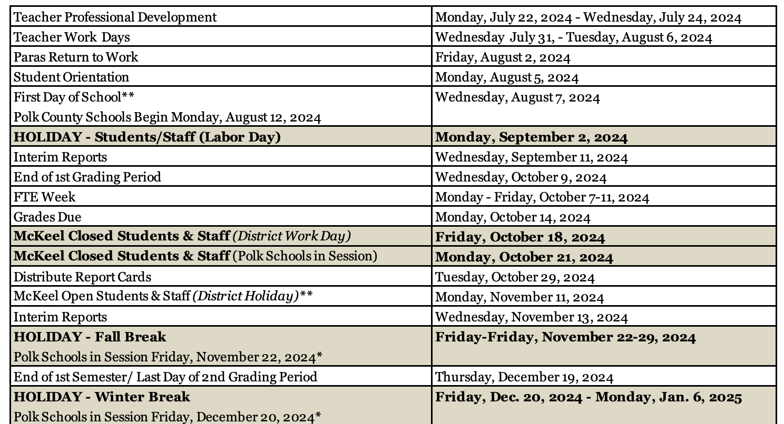

Slide 25
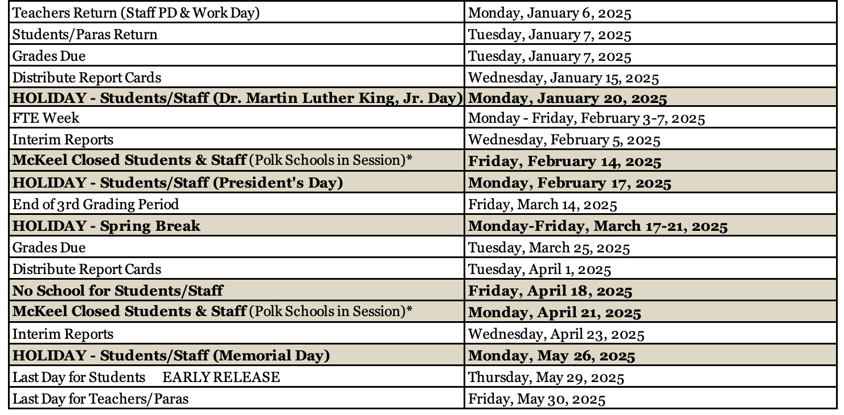

Slide 26


More information will be coming home soon about our scheduled field trips for the entire year.
There is a $30 first semester due for ALL students. This will include the cost of our first grade
field trip shirt and first
semester field trips.
Please pay by 9/12.
Parents have the option
to buy a field trip shirt on MOO for $15.

Slide 27
1st Semester Field Trips:
Tuesday, October 2nd: “Alice in Wonderland, Jr.” Children’s Play @ Lakeland Community Theater & lunch @ Barnett Park
October (TBA): Lakeland Police Station
December (TBA): Nursing Home & Barnett Park

Slide 28




McKeel Academy Central does not celebrate student birthdays. However, I will recognize your child’s special day with a birthday crown and a “Forever Book”. Your child may bring in a snack for the class to share on their special day. Please contact me directly to make necessary arrangements for your child’s special day.

Slide 29

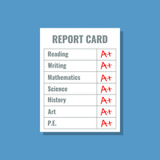
October 29, 2024
January 15, 2025
April 1, 2025
May 2025

Slide 30

STAR Testing
Your child will take the STAR Reading and STAR Math Assessments 3 times during the school year. This is a computer-based assessment so students will be using their iPads to take the assessment.
  PM #1: Fall - Scheduled for 9/5 & 9/6
  PM #2: Winter - TBA
  PM #3: Spring - TBA
  STAR reports will be sent home after each assessment period in your child’s Take Home Folder.

Slide 31
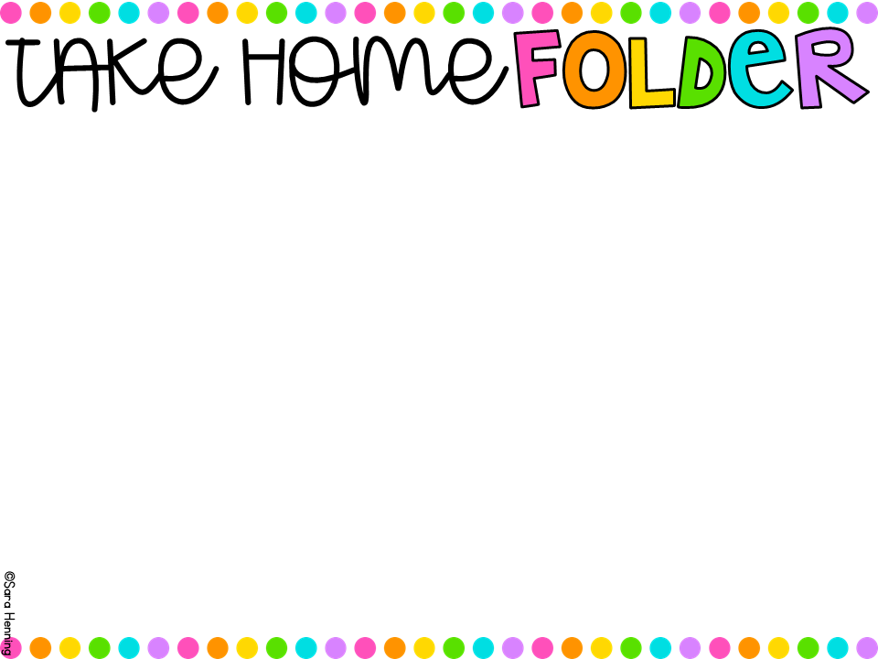
Students will bring home their YELLOW Take Home folders every Friday. Included in the folder are papers your child has completed in class and graded assignments/assessments.
Please be sure to clean out the folder and leave the papers at home.
Please return the folder to school each Monday.

Slide 32

Volunteer Applications are now open. You WILL need to be an Approved Volunteer for ANY field trip you plan to attend. You will also need to have your ID scanned before the first field trip.
https://apps.raptortech.com/Apply/NDE5Mzplbi1VUw==
I will let you know when activities are going on in the classroom for you to sign up to help.

Slide 33
We have a Class Amazon Wish List. Throughout the year, I will add items to this list. Additionally, we will do several room transformations this year and specific items will be needed to make these “special learning experiences” possible. Information will be sent out to families so they can help support our classroom if they would like.

Slide 34
MAC PTO
Helps support the teachers and staff with enhancing and enriching the educational opportunities for our students. With your support the MAC PTO has been able to:
    Provide yearly grants to all teachers to support their educational instruction
    Support House Activities
    Purchase Playground Equipment
    Purchase 3-D printers & Technology Equipment
    Purchase New Gym Bleachers
    Purchase Banner/Sign Machine
    Sponsor Science Nights
    Sponsor Teacher Appreciation Week/Breakfasts/Luncheons & Sponsor Teacher Birthday Gifts
    Book Fair Support
    Sponsor the MAC Christmas Float
    Sponsor Field Trips
    Sponsor Spirit Nights
    Sponsor Father/Daughter Dance & Mother/Son Event
    You can help support the MAC PTO!
    For more information email: macpto@mckeelschools.com
    Make sure to like the McKeel Academy Central PTO Facebook Page (Maroon Paw).
      Join the PTO as a Member for $5 per Family (form to be filled out)
      Purchase a Parent Spirit Shirt
      Sponsor a Gym Paw Print for $25 (form to be filled out)
      Support the Walk-A-Thon the PTO’s biggest fundraiser
      Send in all Grocery Receipts with your child (PTO will scan the receipt using the Box Top for Education App)
      Use SMILE.AMAZON.COM to shop online (choose McKeel Elementary Academy as your charity (our previous name)
      Attend the Monthly Spirit Nights at local Lakeland eating establishments
      Volunteer with the PTO and in your child’s classroom

Slide 35


First grade relies highly on the support from parents with reading at home each night.
We ask that you read with your child at least 3 nights a week for 15-20 minutes. You may read to your child or have them read to you.
Also, please work on the sight word list for each 9 weeks.

Slide 36

Please feel free to reach out with any questions or concerns you may have.
You can contact me either through:
Email: gretchenmartinez@mckeelschools.com
Remind: Message me directly
Agenda: Write a note in your child’s agenda and I will respond back that day.

